Slide 1
RA 505 Robot Sensing and Vision Lecture 29
Dr. Rishikesh Kulkarni
Department of Electronics and Electrical Engineering
IIT Guwahati

Slide 2
Optical black pixels and dummy pixels

Slide 3
Optical format and pixel size

Slide 4
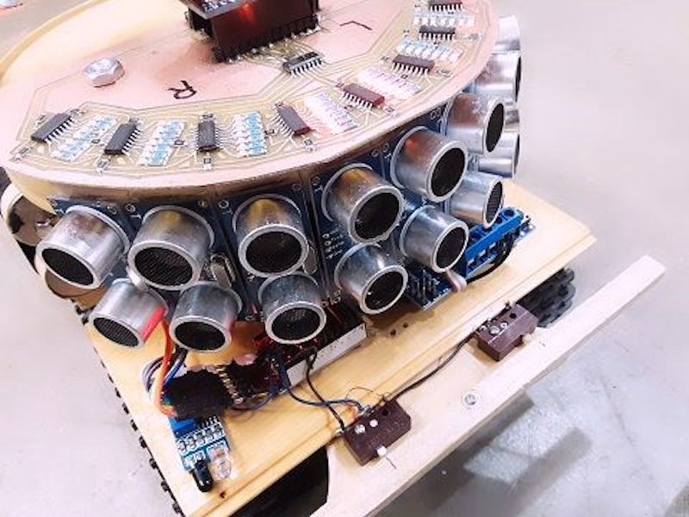
Ultrasonic rangefinder
Ultrasonic devices
Measurement of flow rate, liquid level, translational displacements
Band of frequencies in the range above 20 kHz
Transmitter and Receiver
Time-of-flight/ Change in phase/frequency
Piezoelectric crystal
Can operate as transmitter and receiver interchangeably
20 kHz - 15 MHz
Quartz, lithium sulphate
application of a sinusoidal voltage at a frequency causes sinusoidal variations in the thickness of the material
As a result, sound wave are emitted at the chosen frequency

Slide 5
Ultrasonic rangefinder
Transmission speed
varies according to the medium
Dependence on temperature, humidity, and air turbulence
V = 331.6 + 0.6 T m/s
Directionality of ultrasound waves
Spherical wave emission of energy
Peak energy in particular direction
Magnitude of energy emission in any direction proportional to angle made with respect to normal to the surface (direction of travel)
attenuation of the transmission magnitude with respect to normal increases
40 kHz : +- 50º , 400 kHz: +- 3º
Effect of air currents

Slide 6
Ultrasonic rangefinder
Wavelength and frequency
Directionality also depends on the transmission horn
Attenuation of Ultrasound Waves: depends on the nominal frequency of the ultrasound and the adsorption characteristics of the medium. Level of humidity, dust

Slide 7
Ultrasonic rangefinder
Ultrasonic range sensor
time between transmission of a burst of ultrasonic energy from an ultrasonic transmitter and receipt of that energy by an ultrasonic receiver
Object distance d
Compensation for variability of v with temperature
Degree of directionality is of not much important if ‘normal lines to Tx and Rx faces are coincident
Low-frequency elements have to be used for the measurement of large ranges
Compromise between measurement resolution and range
Measurement accuracy

Slide 8
Ultrasonic rangefinder
Effect of noise
Outputs are usually of low amplitude
prone to contamination by electromagnetic noise
Locating amplifier as close as possible to the receiver
serious form of noise: background ultrasound
sound-absorbing material: minimizes interference
ultrasonic energy emission at angles other than the direction
transmission-time counter

Slide 9
Ultrasonic rangefinder
Doppler Shift in Ultrasound Transmission

